Slide 1
Cryptographic message encoder & decoder
TEAM MEMBERS
CB.SC.U4AIE24106-HARSHA .C
CB.SC.U4AIE24137-PRANEETH .M
CB.SC.U4AIE24145-ROHITH .P
CB.SC.U4AIE24139-SUPREETH .N

Slide 2
introduction
This project is about encrypting and decrypting messages using two methods: Affine Cipher and RSA.
Affine is fast and simple, while RSA adds strong security by safely sharing keys.
By combining both, we make messaging both unpredictable and secure.

Slide 3
OBJECTIVES
To use the Affine Cipher for quick and simple message encryption.
To apply RSA for secure key sharing and strong protection.
To combine both methods for a safer and more efficient way to send messages.
To protect messages from being read or changed by anyone else.
To learn how classic and modern encryption can work together in real applications.

Slide 4
S.NO | Paper Name | Year | Methodology | Key contribution
1 | A New Approach of Cryptography for Data Encryption and Decryption | 2022 | This paper uses a new encryption method that creates a unique key from random characters for every text and then converted into binary | This method improves a new data security by adding more randomness to encryption, performing better and faster
2 | Chaotic Encoder-Decoder on FPGA for Crypto System | 2022 | Used chaotic behavior in digital filters for encryption . Implemented the system on an FPGA for fast processing | Tested and confirmed that chaotic cryptosystems can work effectively
3 | Secure Data Communication and Cryptography Based on DNA-Based Message Encoding | 2021 | Used DNA sequencing concepts for encrypting data and Combined DNA-based encoding with traditional encryption methods | Developed a new security method using DNA-based cryptography .
4 | Designing of AES Algorithm Using Verilog | 2020 | Used Verilog to implement AES encryption . Implemented the design onto an FPGA . | Made AES encryption faster and more efficient on FPGA .Developed hardware-based security for IOT systems .

Slide 5
methodology
FOR ENCRYPTION
[User Input]
↓
[Affine Encryption]
↓
[RSA Encryption]
↓
[Encrypted Message]
FOR DECRYPTION
[Encrypted Message]
↓
[RSA Decryption]
↓
[Affine Decryption]
↓
[Original Message]

Slide 6
APHINE CHIPHER USES
E(x)=(ax+b)mod26 [for encryption]
D(y)=((a^−1)⋅(y−b))mod26 [ for decryption]
a (multiplicative key) must be coprime to 26 ; b is an additive key.
X is the position of the letter in the alphabet ; Y is the encrypted character number
RSA ENCRYPTION
Two prime numbers p and q are selected → n=p x q ; Then Euler’s totient function ϕ(n)=(p-1) x (q-1).
Then it computes the modular inverse d(decryption key ),satisfying ; e.d ≡ 1 modϕ(n)
it gives public key (e , n) for encryption and private key(d , n) for decryption
It converts the character into its ASCII value and applies the formula: C=P^e mod n ->[for encryption]
It takes each encrypted value c and decrypts it using P=C^d mod n ->[for decryption]
P=plaintext character’s ASCII value and C= encrypted numerical value

Slide 7
Why our hybrid model is better
Layered Protection : Combining symmetric (Affine) and asymmetric (RSA) encryption adds multiple layers of defense against attacks.
More Randomness: The combined effect introduces more unpredictable patterns in ciphertext.
Minimized Repetition: The hybrid model minimizes repetition in ciphertext, even if the input has repeating characters, improving unpredictability

Slide 8
Why Affine Cipher Is Considered Insecure
The Affine Cipher is easy to break because it always replaces a letter with the same one, making patterns in the ciphertext. This allows attackers to guess the original message using brute-force attacks (trying all possible keys) or frequency analysis (looking at the common letters). Because it doesn't mix up the data much, it's not strong enough for modern security needs.

Slide 9
Chi-square Test
The Chi-Square test is a method used to determine how much a set of observed data differs from expected data. In encryption, it helps us measure how much the character distribution in the ciphertext deviates from the typical distribution found in the English language.
A higher Chi-Square value indicates that the ciphertext is more random and does not resemble the original plaintext
A lower Chi-Square value suggests the ciphertext is too similar to original text, meaning the encryption might be weaker

Slide 10
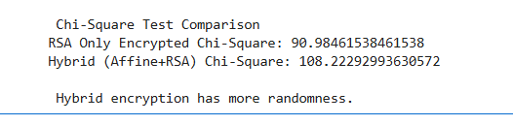
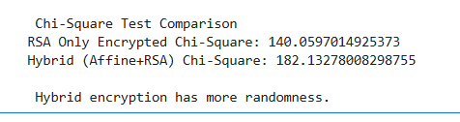
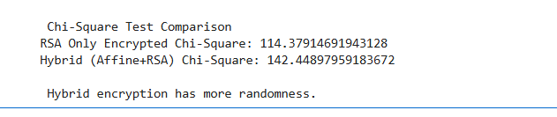
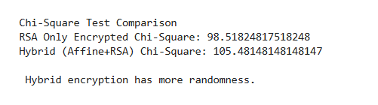
CHI-SQUARE TEST ANALYSIS

Slide 11
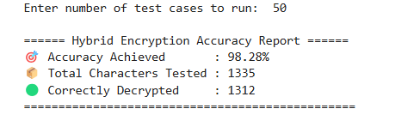
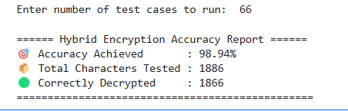
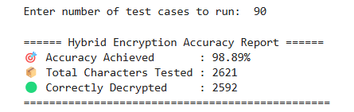
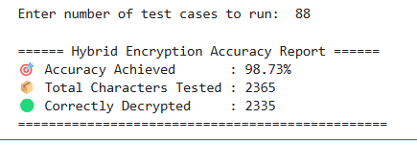
Accuracy testing
We have tested our model with various sentences and test cases, and it consistently achieved an accuracy of 98%.

Slide 12
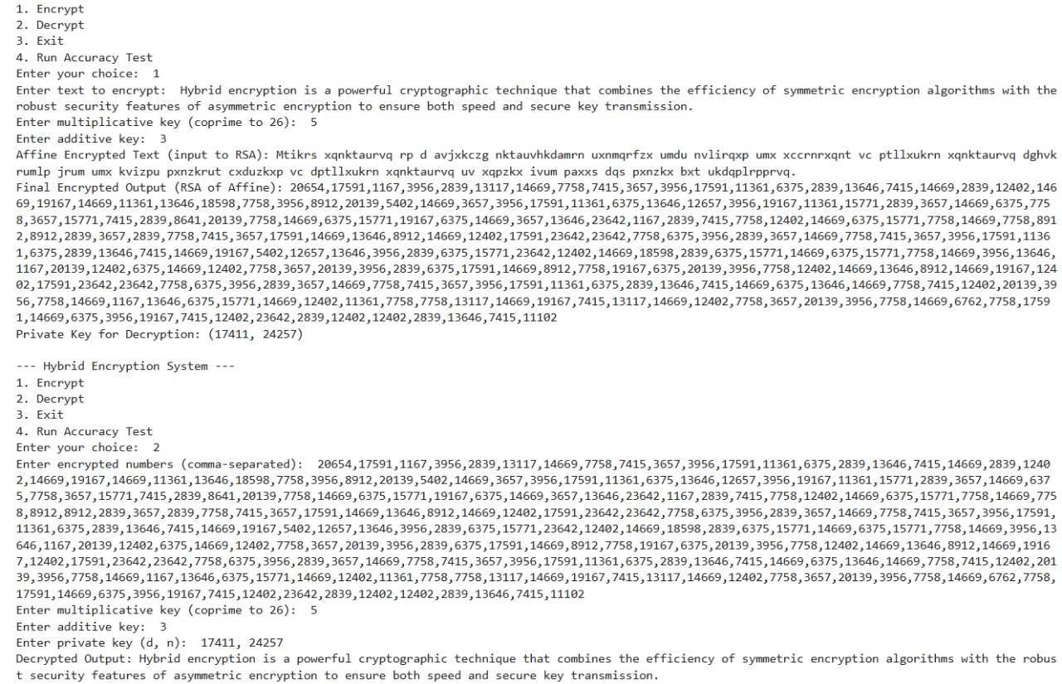
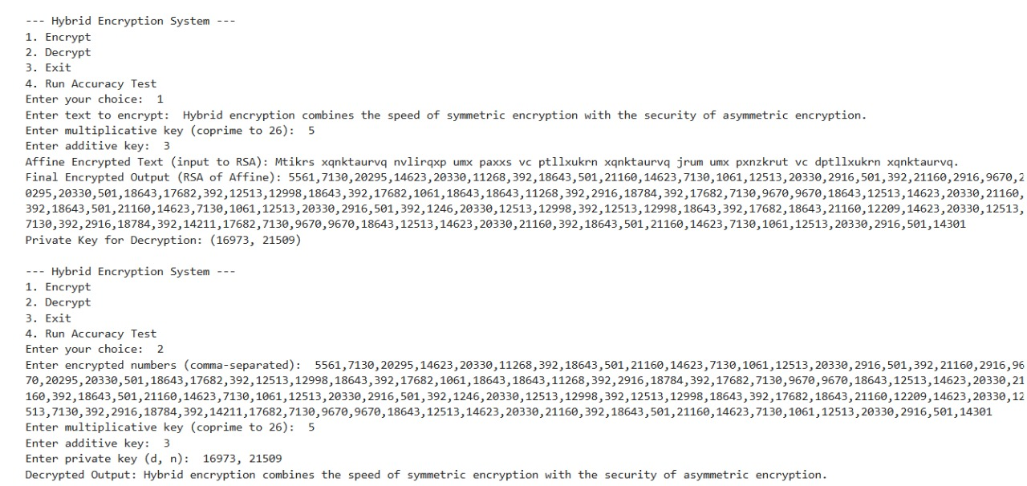
RESULTS

Slide 13
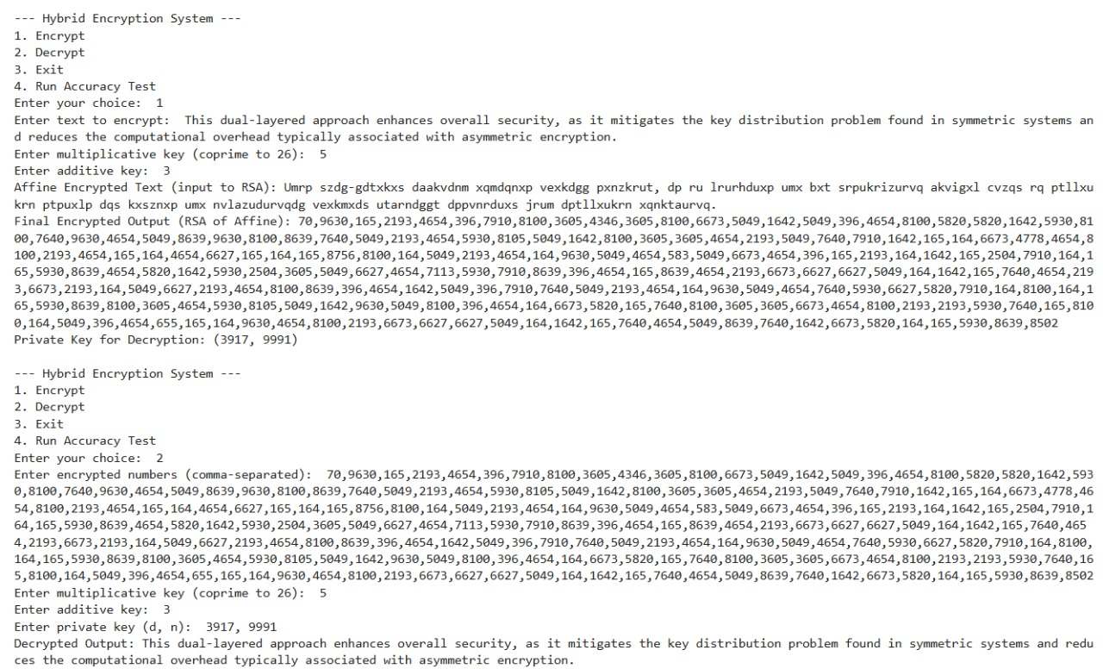
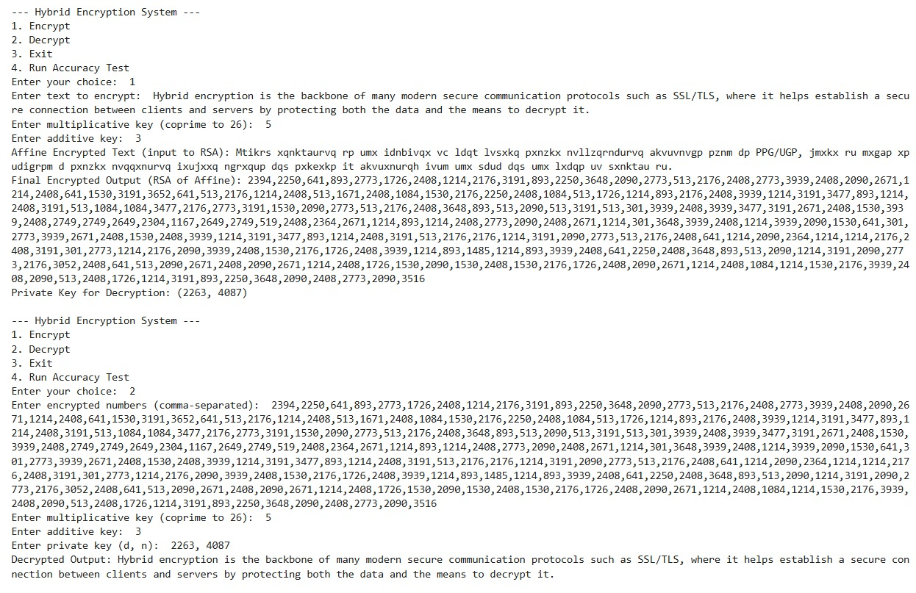

Slide 14
discussion
This hybrid encryption method combines the speed of the Affine Cipher with the strong security of RSA. Affine Cipher is fast and easy to apply, while RSA is more secure but slower. By first encrypting the message with Affine and then using RSA, we reduce the amount of data RSA has to handle, which makes the process slightly faster than using RSA alone. This approach provides a good balance between speed and security. During testing, the system showed high accuracy and worked well for secure and quick message encryption.

Slide 15
FUTURE SCOPE
The system can be extended to encrypt files, images and real-time communication data.
A graphical user interface (GUI) and IoT compatibility can enhance usability and practicality.
Performance improvements can be achieved through optimized key generation and multi-threading.
It has strong potential for use in educational tools and lightweight secure messaging apps.

Slide 16
Conclusion
This hybrid encryption method uses Affine Cipher for fast text scrambling and RSA for strong security. Together, they make the system more secure and reliable. It is an efficient approach for data encryption and decryption. It provides safer data on the internet communication system, as well as for organizational, personal, and business purposes, etc. The experiment result shows that our proposed approach has the highest Chi-Square test value compared to RSA.

Slide 17
reFERENCES
https://ieeexplore.ieee.org/document/9756078
https://ieeexplore.ieee.org/stamp/stamp.jsp?tp=&arnumber=7019464
https://ieeexplore.ieee.org/stamp/stamp.jsp?tp=&arnumber=7041740

Slide 18
THANK YOU

